Slide 1

Patroller Wellness 101

Slide 2
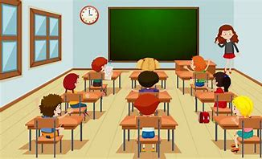
Todays goal is to present a 101 class or ‘Patroller Wellness’ awareness class to all of our patrollers. This is done in a mandatory training or it can be put on video and put online with mandatory viewing.

Slide 3
NSP The Patroller Wellness Task Force
Goals and Objectives
1. Develop an awareness of Patroller Stress Injury.
2. Eliminate the stigma related to stress injury.
3. Prioritize patroller wellness and safety.
4. Encourage and support local patrols to develop their own program in Patroller Wellness.

Slide 4
Patrollers face stressful situations every day in the course of performing their jobs.
Whether patrollers are paid or volunteer, most join the National Ski Patrol for a love of the sport, camaraderie, a challenge to learn new skills and to help others.
Patrollers may not be aware that while caring for ill or injured patients that they too could be impacted.

Slide 5
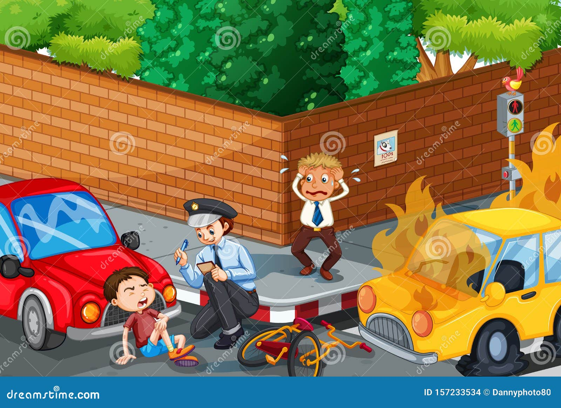
70%-90% of adults in the United States will be exposed to a traumatic event during their lifetime.

Slide 6
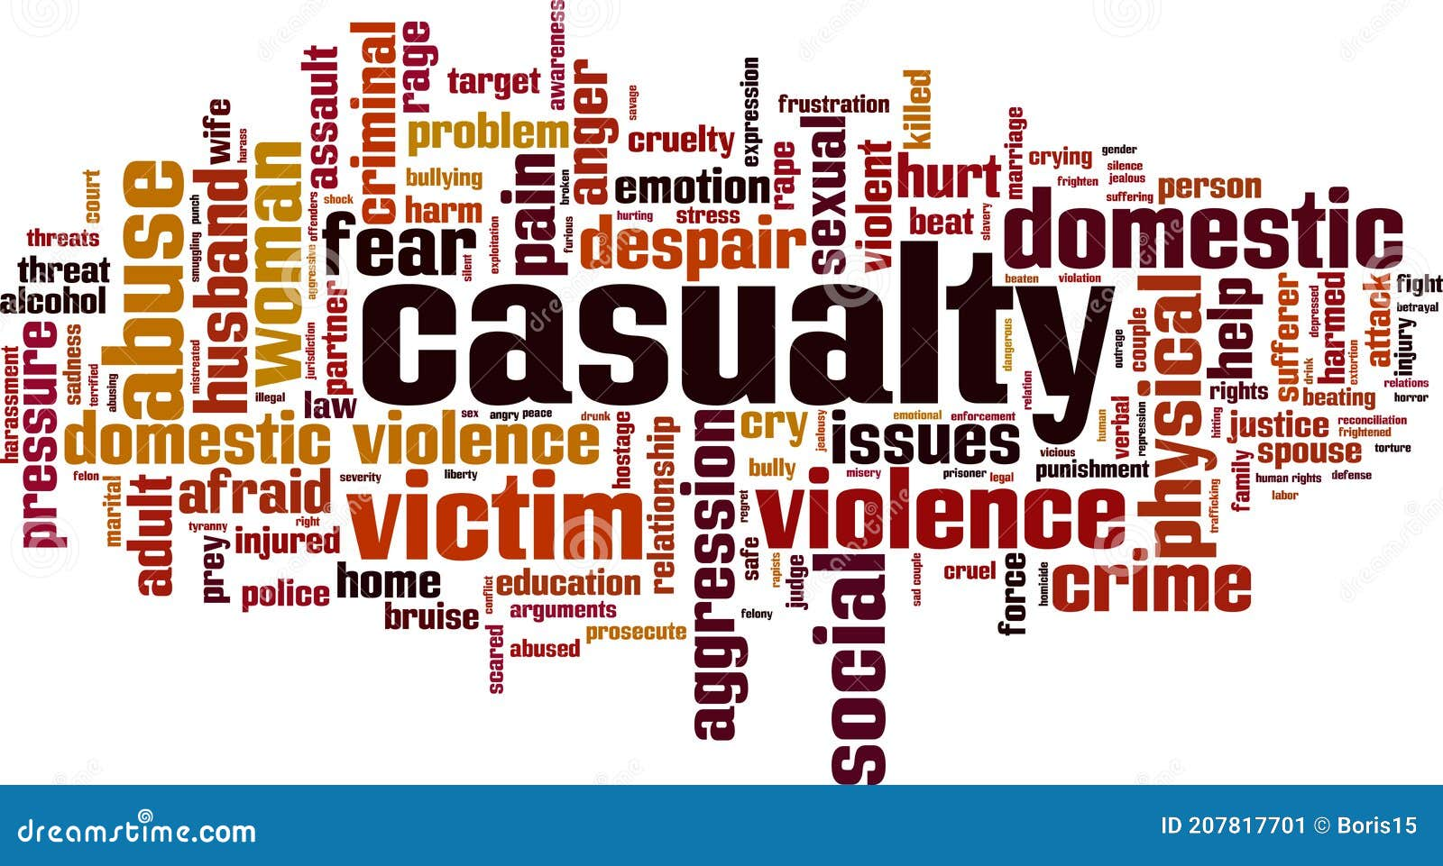
• On average first responders are exposed to approximately 800 traumatic events in their careers

Slide 7

Raise your hand if you have responded to a really good call. I’m talking about the ones where the patient was wrapped around a tree or legs or arms were not pointing in the right direction. Maybe there was lots of blood. You know the kind I'm talking about.

Slide 8
Why do we say it was a good call?
In our OEC training we learned what to do. We put our skills to the test and hopefully have a good outcome for the injured.
What we call a good call is actually a BAD call for normal people.

Slide 9
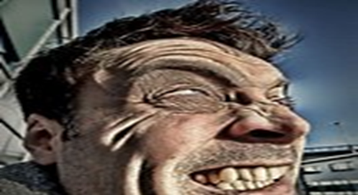
We are not normal

Slide 10
CRITICAL INCIDENTS are unusually challenging events that have the potential to create significant human distress and can overwhelm one’s usual coping

Slide 11

Today I want you to learn!
Not what to expect during an incident,
but what to expect after the incident.

Slide 12
BODY RESPONSE DURING THE INCIDENT
• Hyper-Focused (Sight / Hearing). • Unneeded senses shutdown.
• Slowing of Time.
• Multiple thought

Slide 13
Patrollers are not all the same or have the same background
How individuals respond to a traumatic incident can be different.
First time exposed.
Previous personal traumatic experience.
Repeated exposure to traumatic incidents
If their own life was threatened

Slide 14
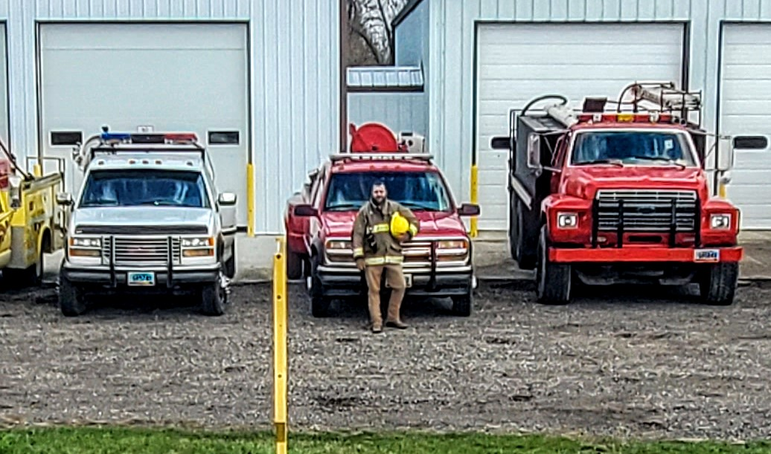
Think about our patrollers who has not seen a bad call or have been on that call and may not be ok after it.
Hot wash?
Notes:
Add a local story or Nick was a newer firefighter who was eager to go on all calls. That day he was the first person on a gunshot call with facial injuries.
He kept his head and did a good job doing emergency first aid. He was a little excited but did good. I did a hotwash with him at the station with all involved.
He did not show any signs of having issues. The next day it hit him hard. He did have someone to reach out to, his sister who was a nurse. I failed to realize that he might have issues. To me it was nothing new and I have responded to this type of call many times. Nick did not have the exposure to this that I have had. Remember these newer patrollers.

Slide 15
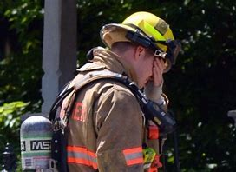
Previous personal traumatic experience
STERLING, N.D. (KFYR) - A 21-year-old Sterling woman sustained life-threatening injuries in a crash around 7:30 p.m. Sunday. The North Dakota Highway Patrol said she was riding a dirt bike in the west ditch of Highway 83 on the south side of Sterling and attempted to cross the highway to the east at 5th Avenue NE.
Notes:
On this call one of our long time firefighters, Lets call him Bob, responded to this call along with Nick. Bob did not go into the ditch and do patient care. He is usually take charge on medical scenes. He called for a helicopter and set up the landing site.
Nick had very traumatic injuries to deal with and did a great job at saving this girls life. After the call we did a hotwash and Bob seemed unusually quite. He said he was ok. The next day I did follow-up with everyone on scene and we set up a group debrief using the EMS Chaplin. Long story short and with Bob’s permission I share this with you. Bob had lost his son in a motorcycle accident and emotionally could not go down in that ditch.

Slide 16
Retention of patrollers
Local News
Construction flagger injured near Wing
by: Morgan DeVries
Posted: Apr 19, 2024 / 05:08 PM CDT
Updated: Apr 19, 2024 / 06:15 PM CDT
Notes:
We need to keep then ones we already have. A flagger on a road crew was stuck by a pickup and tossed in the ditch. Multiple injuries. Talking to a witness, he said he seen it happen and he had seen it happen before. He was very shaken up. He stated he had been a firefighter before for a different dept. and was on the same type of call. At the hotwash they asked him how he was doing. He was ok then. It hit him the next day and there was no follow-up with him. He had a stress injury and no help. He quit the fire dept. remember it doesn’t hit everyone at the same time.

Slide 17
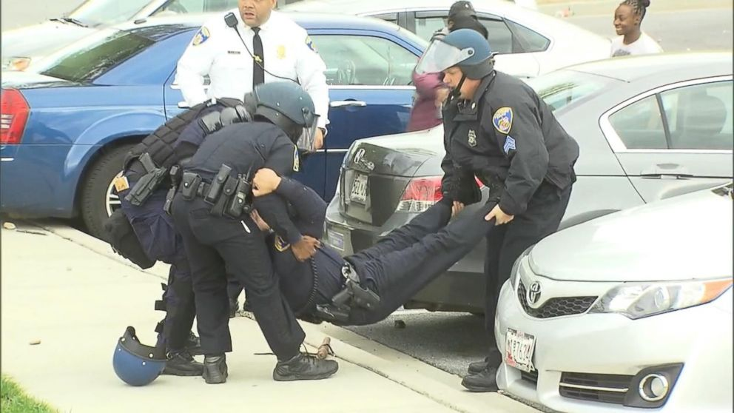
If their own life was threatened

Slide 18
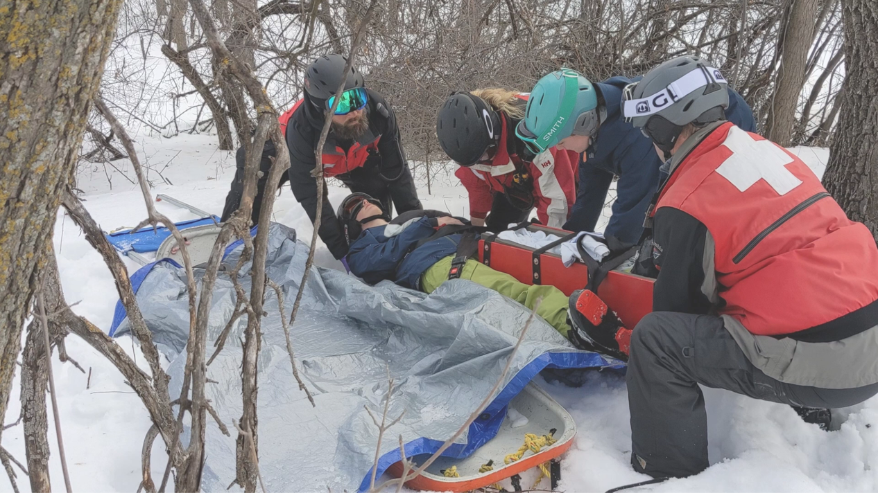

Slide 19
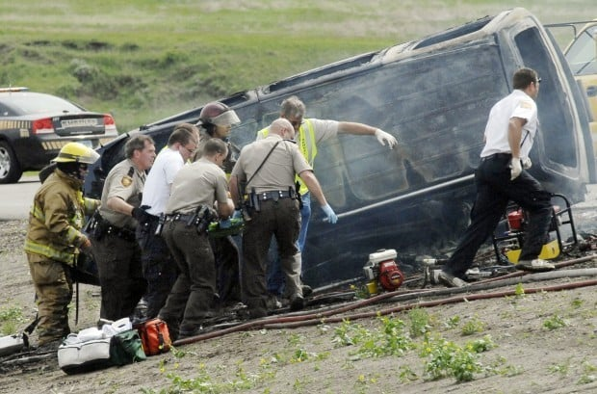
Lots of us have those stories inside of us that we have not shared or not ready to share. Again, it not hard to talk about the incident, but to share our feeling and emotions we felt after that call.

Slide 20
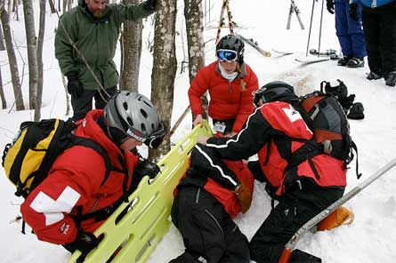
It is very common, in fact quite NORMAL, for people to experience aftershocks (strong emotional or physical reactions) when they have involved in a traumatic event.

Slide 21
Physical reactions
Exhaustion
Nausea/vomiting
Weakness
Difficulty breathing
Chest pains
Rapid heart rate
Headaches
Dry mouth/always thirsty
Elevated blood pressure
Fainting/dizziness
Exacerbation of allergy problems
Symptoms of shock

Slide 22
Cognitive reactions
Blaming attitude
Confusion
Reduced attention span
Flashbacks
Poor concentration/loss of confidence
Negative self-talk/loss of confidence
Decreased awareness
Troubled thoughts
Nightmares
Easily distracted
Short-term memory disturbance
Time/place/person distortion

Slide 23
Emotional reactions
Frustration
Strong need for recognition of what they experienced
Anxiety
Guilt/feeling strongly for victims
Sense of loss
Anger
Denial
Fear of loss of control
Irritability/agitation
Depression
Feeling overwhelmed
Feeling isolated
Loss of emotional control

Slide 24
Behavioral reactions
Emotional outbursts
Change in activity level
Disturbed sleep
Increase in smoking
Easily startled/ hyper-vigilance
Antisocial behavior
Withdrawal
Change in eating habits (increase or decrease in food consumption)
Difficulty relaxing
Fidgety/restless
Increased use of alcohol and other drugs
Change in sex drive

Slide 25
Reaction to a stressful event
Hot wash
24 hours
Days
Weeks
Months
Years
Notes:
Each person can have a different reaction to a stressful incident. After the adrenalin wears off you can feel overwhelmed. This can hit you anytime. For me it has happened about 24 hours after. It can hit you anytime.

Slide 26
333
3 days, 3 weeks, 3 months
911
9 hours 1 day 1 week
Notes:
333 is a reminder to check in on the patroller with a possible stress injury. 911 is also 9 hours 1 day 1 week

Slide 27
Things to do after.
Physical exercise
Keep busy
Reach out, talk to someone. Talk is the most healing medicine
Avoid drugs and alcohol
Sharing your feelings to others involved helps them and yourself.
Get plenty of rest. Remember dreams and flashbacks can happen, but are normal. They will decrease over time.
See handout for more info.

Slide 28
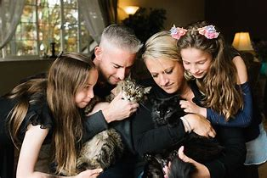
For family members and friends
Listen carefully
Spend time with traumatized person
Offer a listening ear even if not asked for one.
Reassure that they are safe.
Give them some private time.
Don’t take their anger or other feelings personally
See handout for more.

Slide 29

Resistance to post stress may be best built by pre-incident/ pre-deployment training.
Notes:
Train for those stressful incidents, plan for those incidents and there will be less stress when they happen.

Slide 30
Designate someone or team for each Patrol
Who should be on our patroller wellness team?
I’m finding the good ones are the people that have been though their own ordeal and know how important it is not to let someone fall through the cracks.

Slide 31
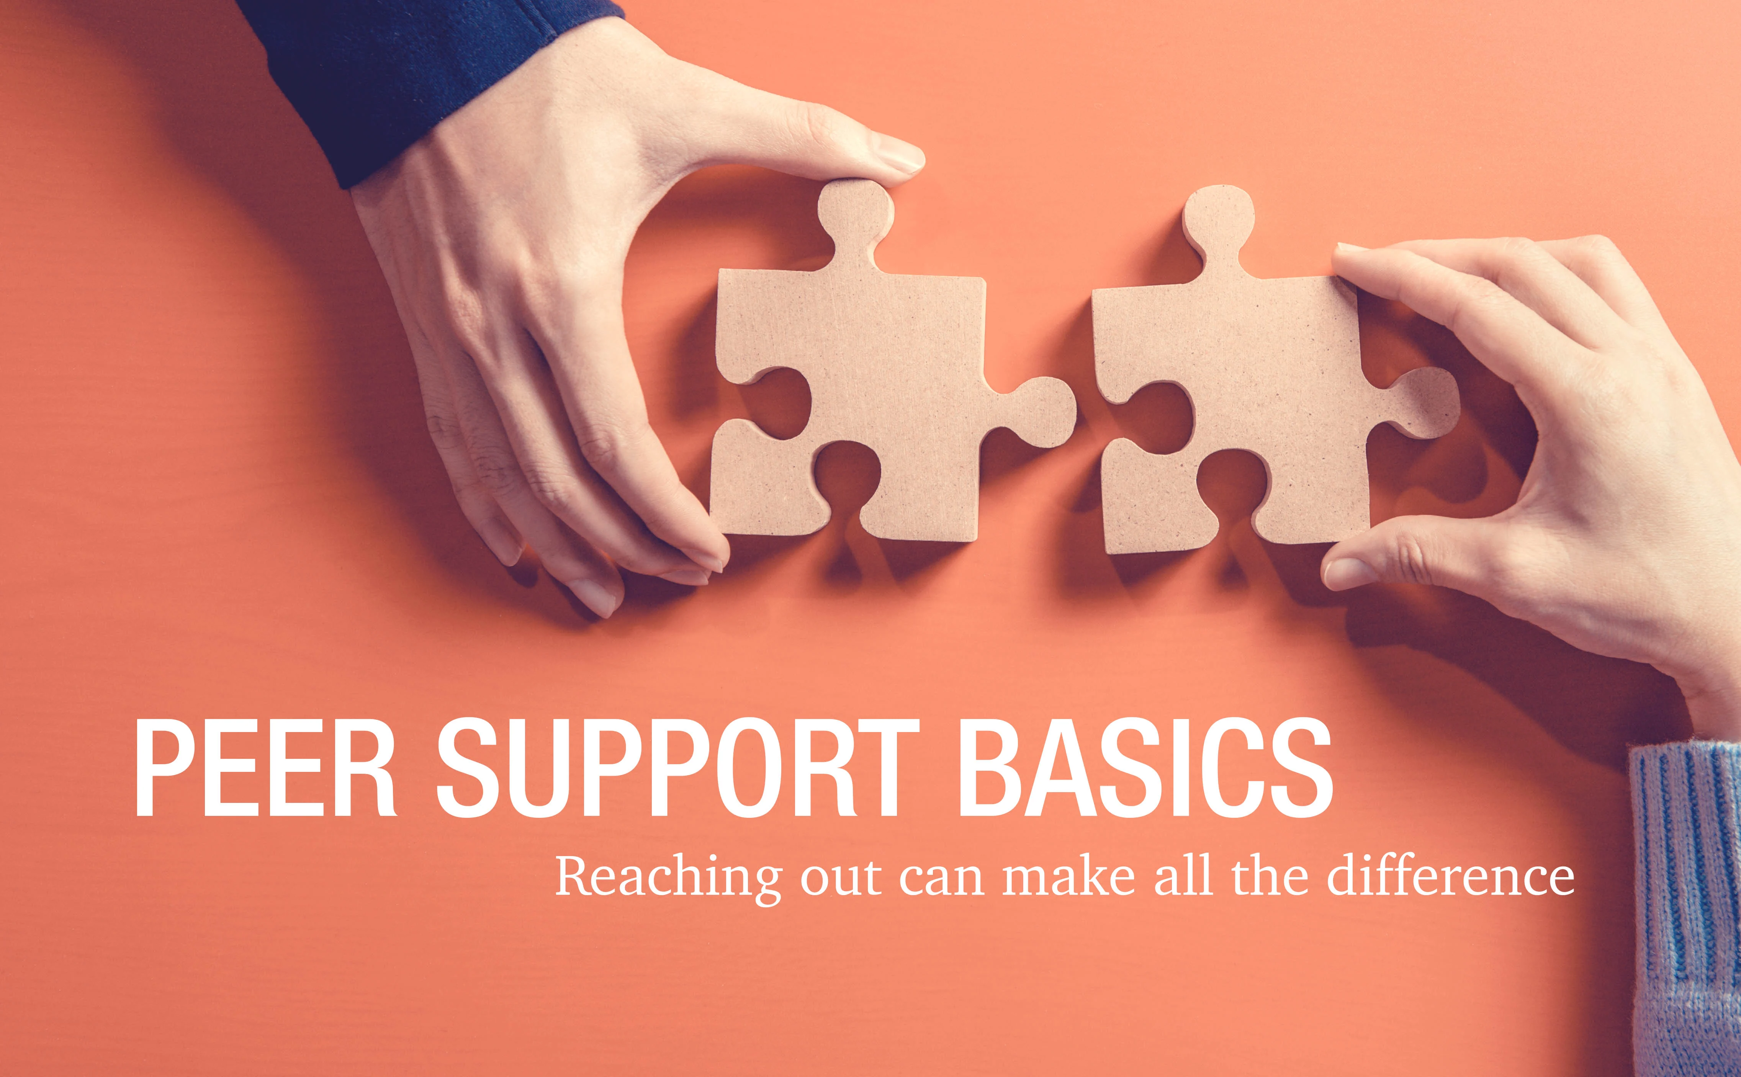
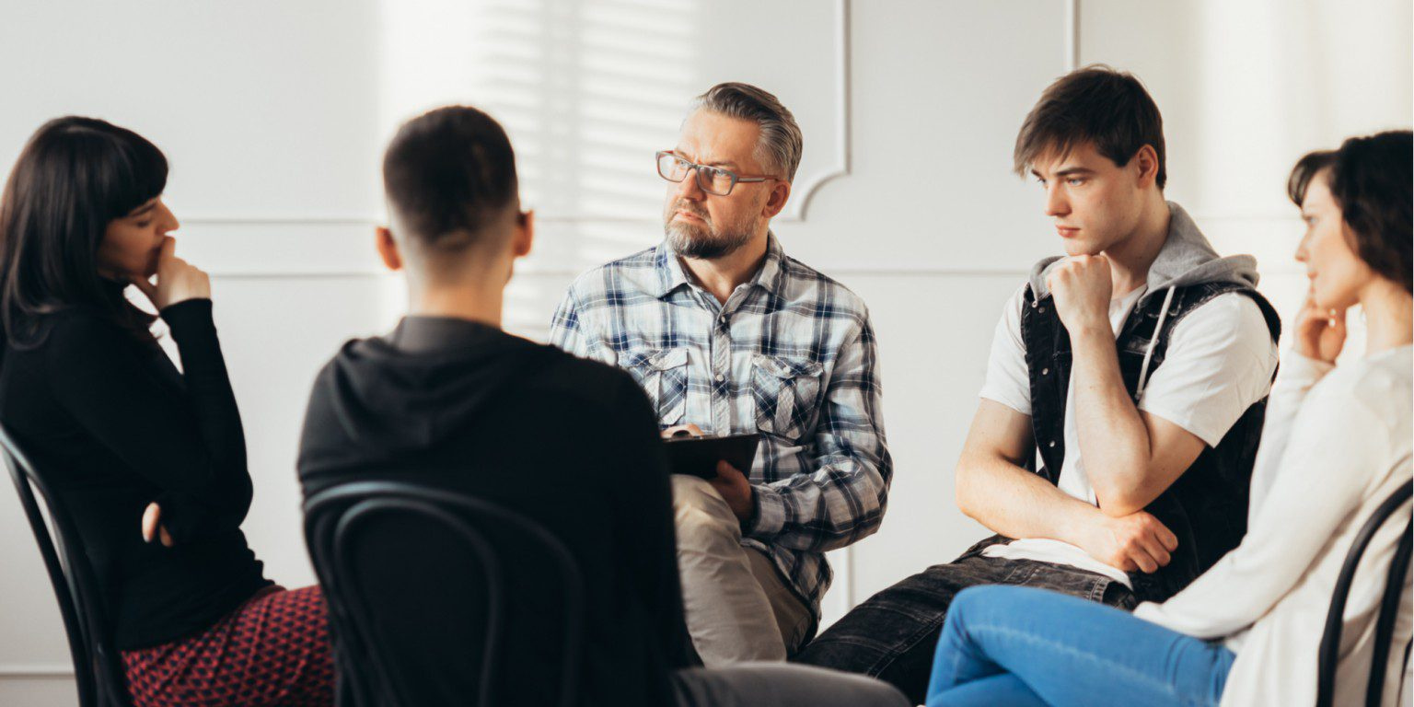
This team should have some Peer Support type training.
Learn about other types of group debriefings they might be involved in.

Slide 32
Learn who and how to contact resources and how to help other get help.
Make contact with those resources ahead of time and create a working relationship. (Ems, law enforcement, fire Chaplin's. State or local agencies trained for this.

Slide 33
Write it into your patrol policy how and who should get notified
when a incident that might create stress or adversely affect one of our own.
Create a division patroller wellness working group to assist other patrols by sharing ideas and resources as needed.

Slide 34

Everyone will be asking you questions and asking how you are doing.
Plan your response to these questions by who is asking them.

Slide 35
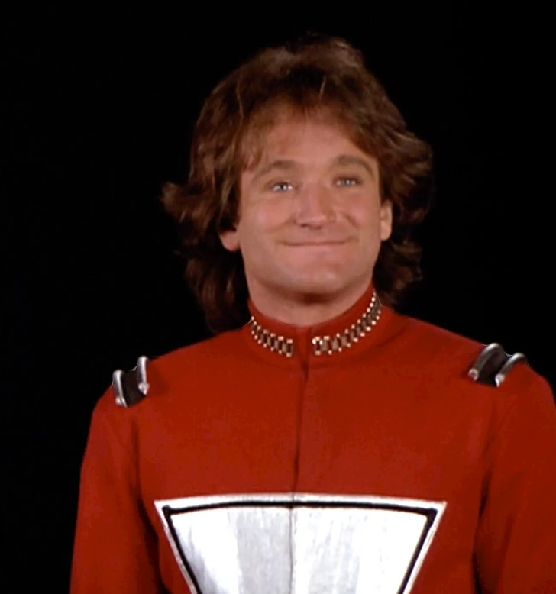

What do you say to the general public?
Mork from Ork.
Notes:
Do like Mork is doing, let the hill or PR person do the talking.

Slide 36

What do you say to close friends and family?
Robin Williams as we knew him.
I’m OK
Notes:
Let them know you went through a bad call, but not all the details.

Slide 37
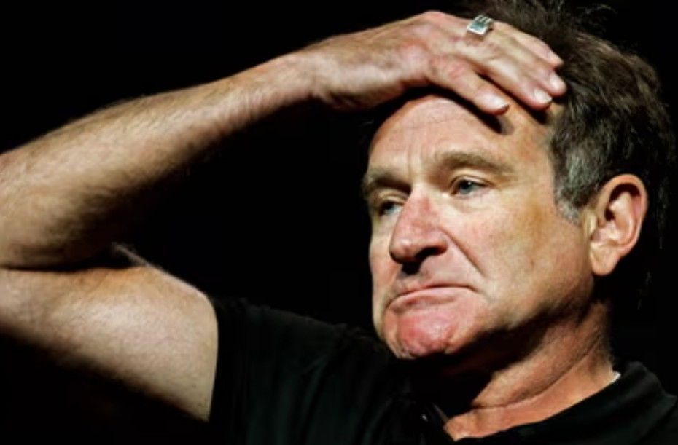
Robin Williams we did not see.
Just asking if they are ok might not be enough.
This is why the peer support team or person follows up.

Slide 38
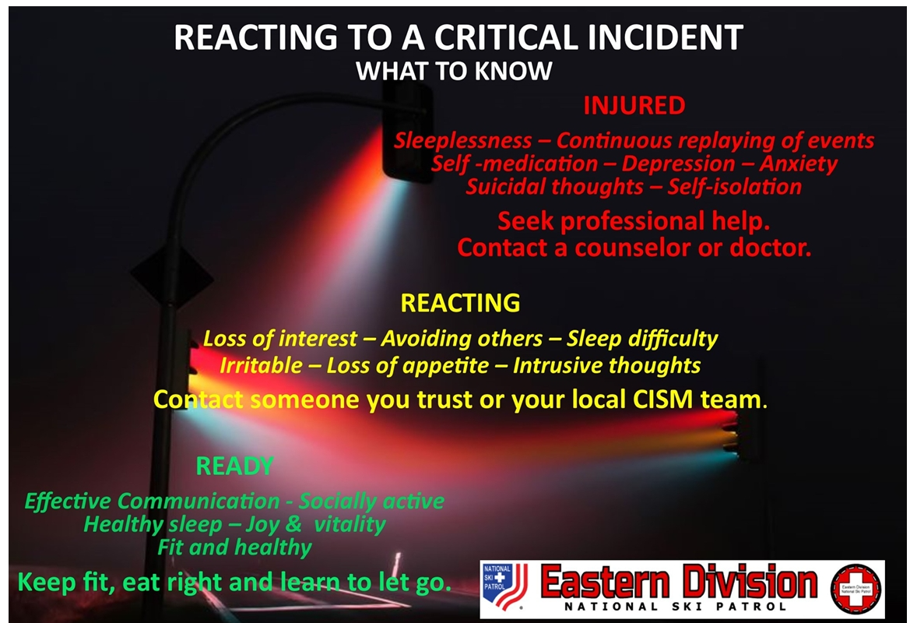

Slide 39
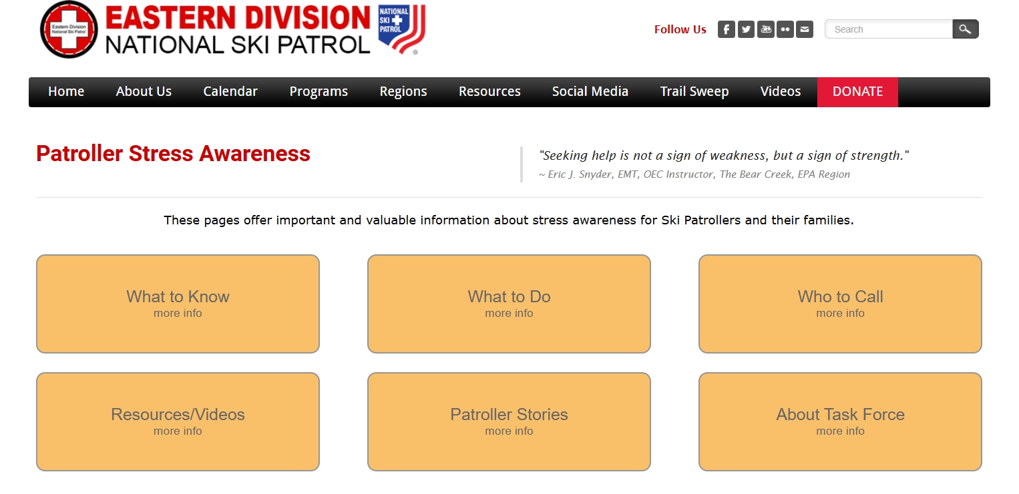

Slide 40
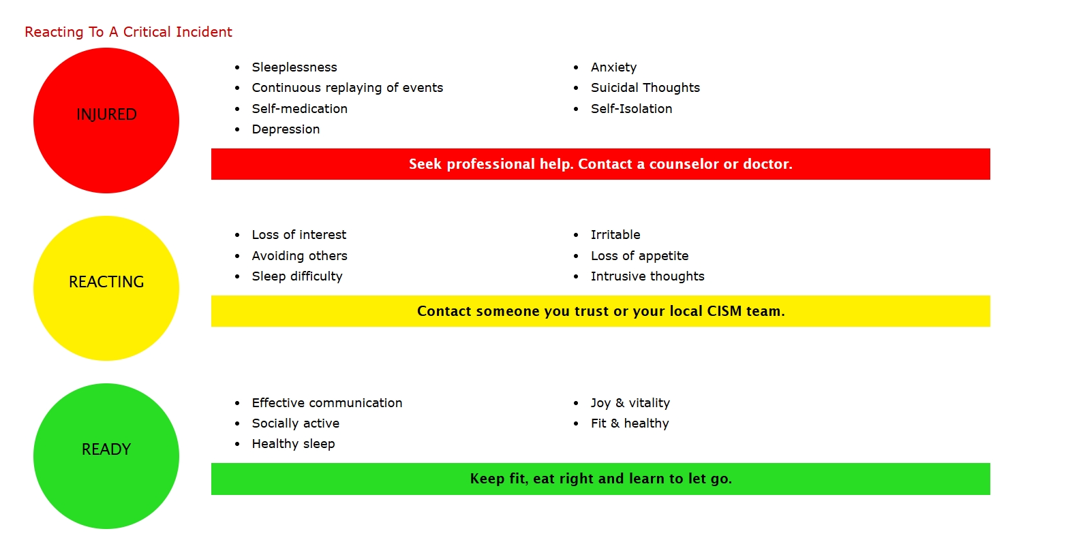

Slide 41
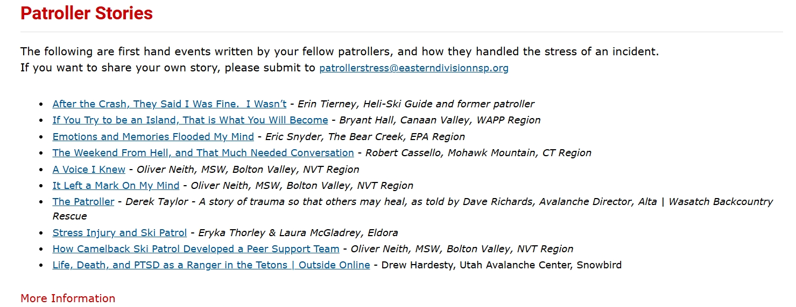

Slide 42
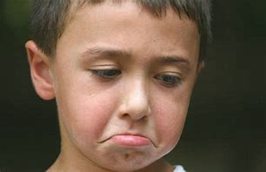
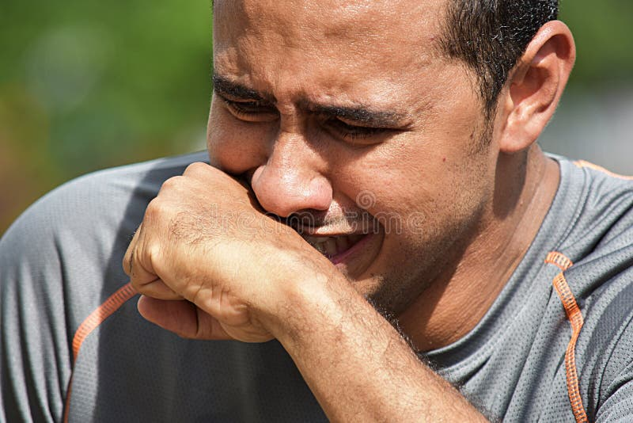
AGAIN
We teach, train and practice what we need to do during an incident.
We need to teach, train and practice what to expect after the incident.

Slide 43
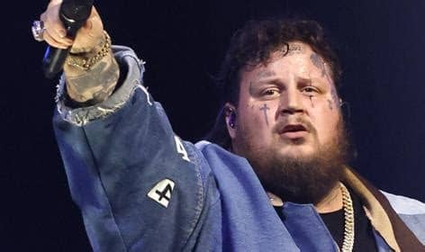
https://youtu.be/Qop5XLgwkNc

