Slide 1
2019-2020 NSP Mentor Program
Pilot Study Proposal
April 2019
Rick Boyce Assistant Director Southern California Region Far West Division 858-386-9533 rhbskier557@gmail.com

Slide 2
What is a Mentor Program?
The purpose of the Mentor Program is to bring closure on a patroller’s initial OEC/OET training, assess their strengths, work towards strengthening their weaknesses and impart in them enough confidence so that they can function independently on the hill as basic patrollers.
Quality mentors are able to ensure that the patrollers they are mentoring feel recognized for their accomplishments and inculcate them into the patrol in a manner such that our new patrollers feel accepted as peers by all.

Slide 3
Program History
Snow Summit Program in place for 10 years, 3 years as BBSP
5 Years of good data
4-5 Mentor days per candidate.
Candidates lead on 6.5 incidents prior to release.
Focus on quality assessment skills and processes.
Supervised execution of first few real life first aid challenges.
Candidates dispatched with good run and route knowledge.
Supervised guest interaction.
Positive Mentor and Candidate Feedback
Patrollers serving as mentors enjoy the process, often ask to work as mentors.
Candidates, both new and transfers have provided nothing but positive feedback on how the mentoring program helped them feel like members of the family.

Slide 4
A Few Ways a Patrol can Benefit
Patrol Leadership
One Advisor can lead the program - no additional administrative load
No costs involved, only time
Resort Management Alignment
Resort maintains high level of confidence in volunteer patrol staff
Resort specific policies reviewed and enforced
Focus on Resort Guest Services Objectives
Patrol Team
Cross Training – Candidates keep their Mentors sharp
Longer term member retention
Bonding and team building
Mentors reinforce continuation of training on to Senior and Certified programs

Slide 5
Pilot Study Objectives
While the program is well developed and the documentation is refined, there is always room for improvement and better human-centered design.
2-4 patrols in each division
No upper or lower limit to number of participants in each patrol
Execute Pilot program for 2019-2020 Season with limited exposure
Collect basic information and anecdotal feedback
Learn from each patrol’s experiences
Improve program – Make Recommendations to National office for further testing or formal adoption by NSP as optional training program.
One season in an Agile Methodology mode and this program can be ready for organization wide release to all patrols.

Slide 6
Resources Available To Launch Pilot Study
Proven Mentoring Guide for Mentors
Detailed Mentor Advisor Guide for leadership/Advisor Role
Rick Boyce available for program Introduction and Training/Mentoring:
Web Based Introduction Video Conferences with each patrol
Ongoing Web Based or Telephone Accessibility
One on One or Group Conference Call
Rick Boyce available monitor all Pilot Studies
Assist with communication protocols
Collect pertinent data
Provide end of season report and further recommendations and efficacy analysis

Slide 7
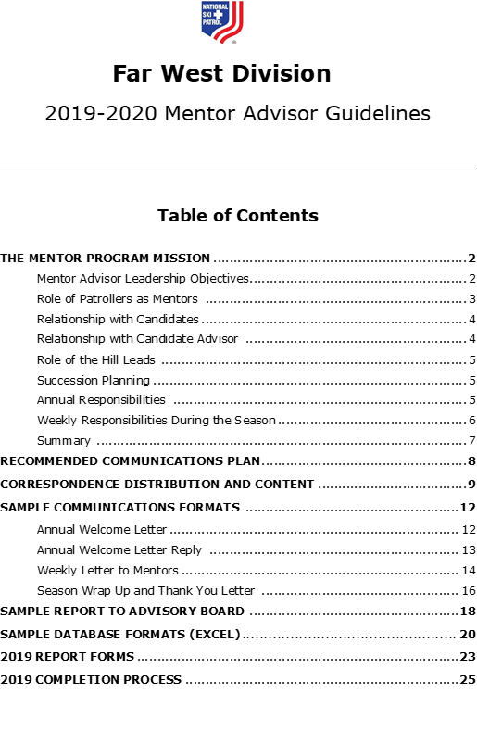
Mentor Advisor Guidelines
Complete Advisor Handbook
27 page reference
Program administration details
Communication planning
Reporting
To Leadership
To Mentors
Database Structure
Forms
Process Model

Slide 8
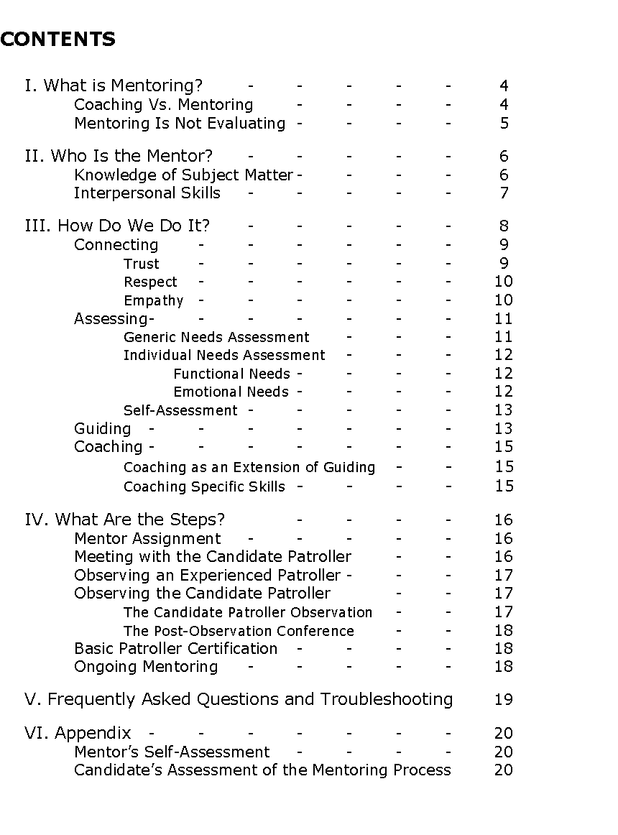
Guide to Mentoring Candidate Patrollers
Proven and accepted Mentoring Concepts
22 page reference
Based on NSP Documents
Coaching vs Mentoring
Connect
Assess
Guide
Basic Steps
Plan the day
Expectations
To Mentors
Philosophy of Reporting
GUIDE TO MENTORING
CANDIDATE PATROLLERS

Slide 9
Straightforward Implementation Process
Patrol Reps Review:
Mentor Guide
Advisor Guide
Patrol Reps Recruit Advisor
Advisors will be mentored by R. Boyce
Advisor will coordinate with Candidate Training Team/Leadership
Initiate communication to whole patrol on the program
Advisor executes Mentoring Program
Coordinate candida/Mentor Matches
Review reports and make recommendations

Slide 10
THANK YOU!
2019-2020 NSP Mentor Program Pilot Study Proposal
April 2019
Program Developed By: Rick Boyce Assistant Director Southern California Region Far West Division 858-386-9533 rhbskier557@gmail.com
Program Contributors: Lance Vaughn
Director, Far West Division
Richard Wilson
Assistant Director, Far West Division
Ron Carroll
Mentor, BBSP

